Slide 1
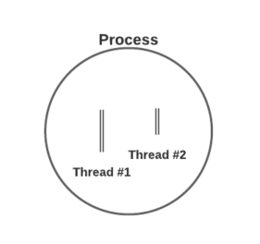
Unit 3 Threads
By:
Amandeep Kaur

Slide 2
A thread is the smallest unit of execution which has its own thread ID, program counter, register set and stack.
All the threads that belong to the same process share the code, data section and other resources like open files belonging to the process.
So, remember thread is a part of the process.
A thread can not exist without a process.
Thread

Slide 3
Which of the following is NOT an advantage of using threads over processes in an operating system?
A) Threads share the same address space, making context switching faster. B) Threads can communicate more easily with each other than processes. C) Threads are more secure and isolated than processes. D) Creating and managing threads is typically more efficient than creating and managing processes.

Slide 4
Ans. C)
C) Threads are more secure and isolated than processes.
Explanation: Threads are not more secure and isolated than processes because threads share the same address space and resources of their parent process, which makes them less isolated. Processes, on the other hand, run in separate memory spaces, offering better isolation and security.

Slide 5
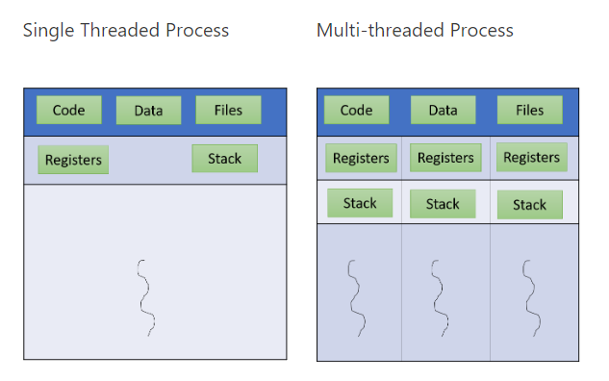
Single Threaded Process V/S Multithreaded Process

Slide 6
Which of the following is a primary advantage of multi-threading over single-threading in an operating system?
A) Increased CPU idle time B) Simplified debugging process C) Improved CPU utilization through concurrency D) More complex process management

Slide 7
Ans. C
C) Improved CPU utilization through concurrency
Explanation: Multi-threading allows multiple threads to run concurrently within a single process, improving CPU utilization by enabling tasks to be executed in parallel, especially when there are multiple cores available. This leads to better overall system performance compared to single-threaded processes that can only execute one task at a time.

Slide 8
Responsiveness – multi-threading increase the responsiveness of the process. For example, in MSWord while one thread does the spelling check the other thread allows you to keep tying the input. Therefore, you feel that Word is always responding.
Resource sharing – All the threads share the code and data of the process. Therefore, this allows several threads to exist within the same address space
Economy – For the same reason as mentioned above it is convenient to create threads. Since they share resources they are less costly
Scalability – Having a multiprocessor system greatly increases the benefits of multithreading. As a result, each thread can run in a separate processor in parallel.
Adv. Of Threads

Slide 9
Challenges for Programmers while creating Threads
Dividing activities – It involves finding the functions within the job that can be run in parallel on separate processors.
Balance – The task assigned to each processor must also be equal. Now there can be different parameters for that. One parameter can be, assign equal tasks to each processor. But tasks assigned to more processor may require higher execution time thus overloading one processor. Thus, simply assigning equal tasks to each processor may not work.
Data splitting – Another challenge is to split the data required for each task.
Data dependency – sometimes the data required by one thread (T1) might be produced by another (T2). Thus, T1 can not run before T2. Therefore, it becomes difficult for programmers to code.
Testing and debugging – Multiple threads running in parallel on multiple cores poses another challenge in the testing of applications.

Slide 10
Multi-threading Models
There are two kinds of threads in the system – user threads and kernel threads.
User threads are supported above the kernel and managed without kernel support.
Kernel threads are supported and managed directly by OS.

Slide 11
Three common ways of establishing such a relationship.
Many to Many
Many to one
One to One
Models(3 Types)

Slide 12
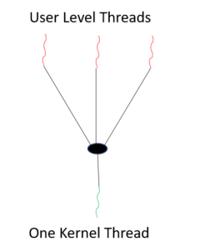
Many to One Model
Many user-level threads mapped to a single kernel thread
Thread library is in user space
Drawback: The Entire process will block if a thread makes a blocking system call
Examples:
Solaris Green Threads
GNU Portable Threads

Slide 13
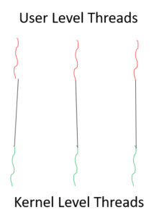
One to One Model
Each user-level thread maps to kernel thread
Drawback: creating a user thread requires creating a corresponding kernel thread. Since the user can develop a malicious application to create unlimited threads. Therefore, the system too have to create those many kernel-level threads. As a result, the system might slow down.
Examples:
Windows NT/XP/2000
Linux Solaris 9 and later

Slide 14
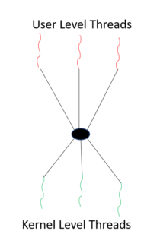
Many to Many Model
Allows many user-level threads to be mapped to many kernel threads
Allows the operating system to create a sufficient number of kernel threads. The operating system creates a pool of kernel-level threads called the thread-pool. As long as a kernel-level thread is available in the thread-pool it is allocated to a user-level thread.
Example: Solaris prior to version 9

Slide 15
Scheduler Activation
Scheduler Activations is a technique used in operating systems to efficiently manage kernel-level and user-level threading. It is designed to bridge the gap between kernel threads and user threads, allowing user-level thread schedulers to interact effectively with the kernel while maintaining the flexibility of user-level threading.

Slide 16
What is the role of scheduler activations in thread management?
a) To dispatch interrupt requests to threads
b) To provide better performance by reducing kernel involvement
c) To automatically handle concurrency at the hardware level

Slide 17
Ans. B
b) To provide better performance by reducing kernel involvement

Slide 18
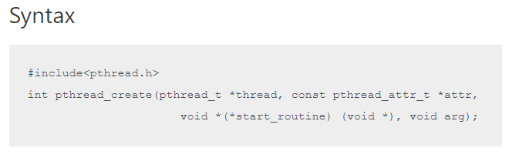
Example of Thread Program

Slide 19
The first parameter is the buffer which will contain the ID of the new thread, if pthread_create is successful.
The second parameter specifies the attributes of the thread. This parameter is generally NULL until you want to change the default settings.
The third parameter is the name the function which the thread will execute. Hence, everything that you want the thread to do should be defined in this function.
Lastly, the fourth parameter is the input to the function in the third parameter. If the function in the third parameter does not take any input then the fourth parameter is NULL.
Example of Thread Program

Slide 20
//Program to create threads in linux. Thread prints 0-4 while the main process prints 20-24
#include<stdio.h> #include<stdlib.h> #include<unistd.h> #include<pthread.h> void *thread_function(void *arg); int i,j; int main() { pthread_t a_thread; //thread declaration
pthread_create(&a_thread, NULL, thread_function, NULL); //thread is created pthread_join(a_thread, NULL); //process waits for thread to finish . //Comment this line to see the difference printf("Inside Main Program\n"); for(j=20;j<25;j++) { printf("%d\n",j); sleep(1); } }
void *thread_function(void *arg) { // the work to be done by the thread is defined in this function printf("Inside Thread\n"); for(i=0;i<5;i++) { printf("%d\n",i); sleep(1); } }

Slide 21
// How to Save,Compile and run Program
program is named “Thread.c”, then to compile write $gcc Thread.c -lpthread To run the command remains same $./a.out

Slide 22
0
1
2
3
4
Inside Main Program
20
21
22
23
24
//Output

Slide 23
How it works?
pthread_create() creates a new thread which starts to execute thread_function. This function creates a loop which prints 0-4. The sleep function makes the thread go to sleep after each digit is printed.
pthread_join() makes the main function wait until the newly created thread finishes its execution. So the control returns to the main function only when the thread finishes. Then the main function prints “Inside Main program” and executes the loop from 20-24.

Slide 24
How a thread returns a value to the main process?
pthread_exit() is used to return a value from the thread back to the main process. The program below shows this. The program also shows how to pass value to a thread from the main process.

Slide 25
References
OPERATING SYSTEM CONCEPTS by ABRAHAM SILBERSCHATZ, PETER B. GALVIN, GERG GAGNE, WILEY
DESIGN OF THE UNIX OPERATING SYSTEM by MAURICE J. BACH, Pearson Education India
REAL-TIME SYSTEMS by JANE W. S. LIU, Pearson Education India
Program to create Threads in Linux - Dextutor Programs
Threads in Operating System - Dextutor Operating System

Slide 26

Thank You

